Slide 1
Cyber Vulnerability Analysis with Nessus
William Fan, Danielle Santos Almeida, Jose Marvin Garcia

Slide 2



Importance of Vulnerability Assessment
Spotting Weaknesses Early
Meeting Rules & Building Trust
Preventing Problems
Regular check-ups on systems help find weak spots before attackers do. Fixing these early lowers the chance of data theft, money loss, or service outages.
Many industries require data protection by law. Assessments show you’re following the rules and keeping customer information safe, which builds trust.
By fixing issues before they’re exploited, organizations reduce risks and stop small weaknesses from becoming big security incidents.

Slide 3

Overview of Nessus & VirtualBox
Nessus utilizes techniques like service fingerprinting and plugin signature matching, categorizing vulnerabilities based on severity
01
VirtualBox - A free tool for running virtual machines, letting you test different operating systems safely on one computer.
02

Slide 4
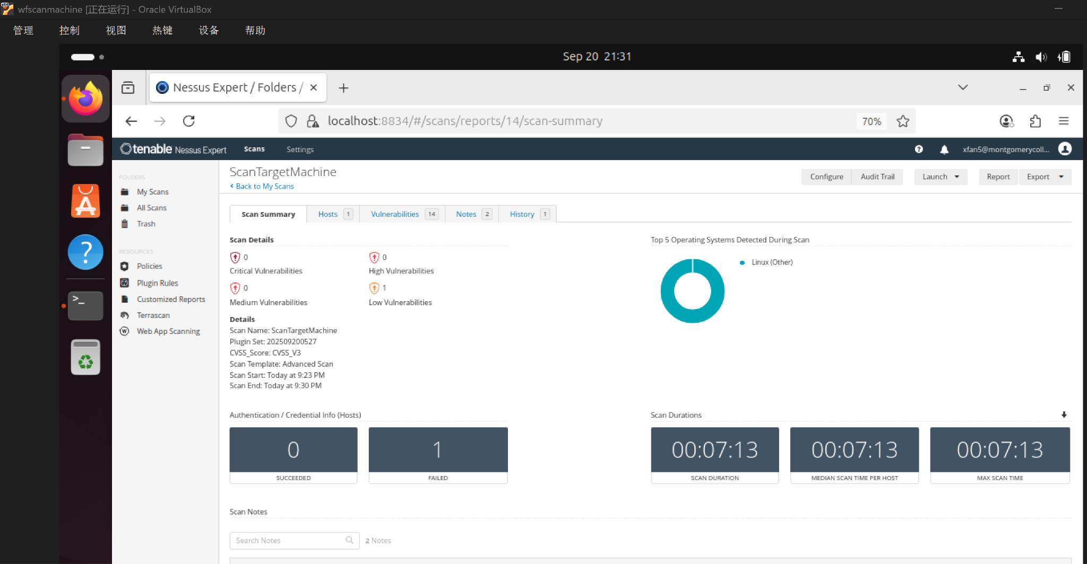

Slide 5
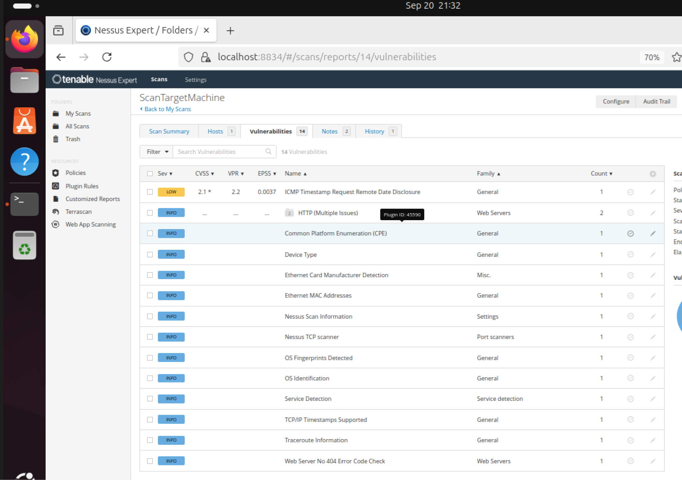
The system responded to a special type of network request (ICMP timestamp), which is considered a low-level risk.
Additional Information Collected – The scan also listed system details (like device type and web server responses), but these are informational only and not security threats.
Overall Low Risk – No high or critical issues were discovered; the findings show the system is secure with only a small, low-impact weakness

Slide 6



Scanning with Nessus tools
No Major Vulnerabilities were found
One Minor Issue
Overall Secure System
A single low-level weakness was identified, posing little to no immediate danger.
The scan detected zero critical or high-level vulnerabilities.
Results show the system is healthy and carries a very low overall risk.

Slide 7

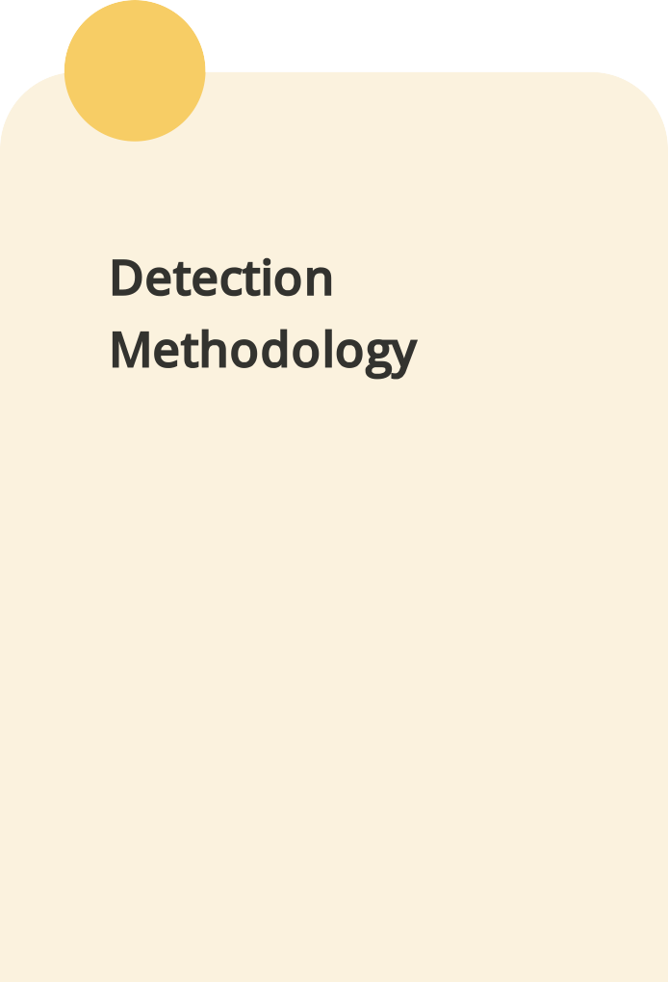

Analysis of detected vulnerabilities
01
02
03
Multiple vulnerabilities identified, including CVE-2025-3248 and
categorized by severity levels.
Nessus employs service fingerprinting, plugin signature matching, and prioritizes risks based on CVSS v3.0 scores.
Plugin #43390 used to detect HTTP vulnerabilities, including CVE-2025- 3248, enabling targeted remediation efforts.

Slide 8
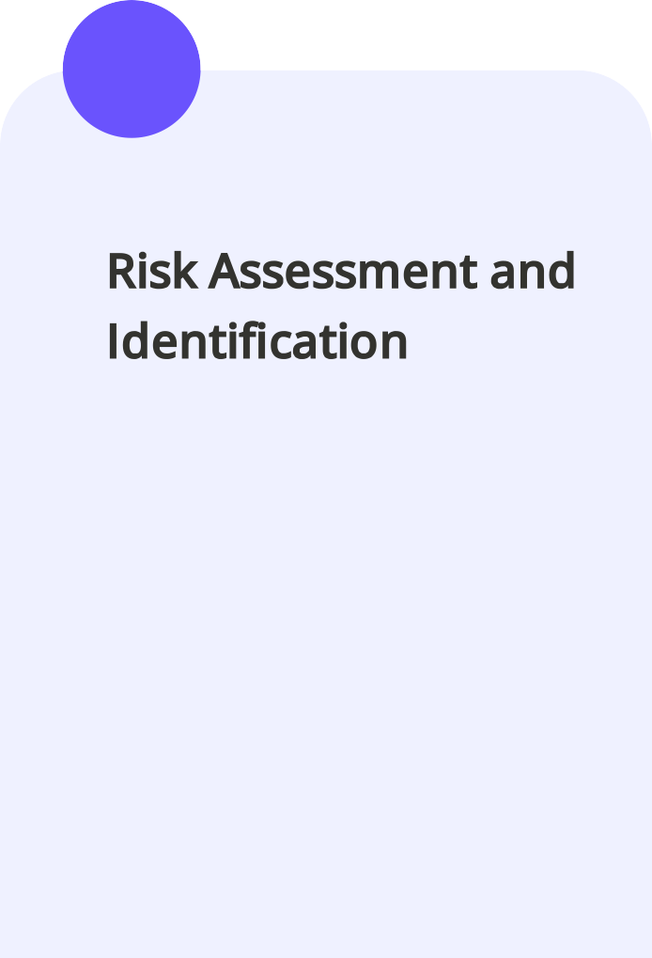
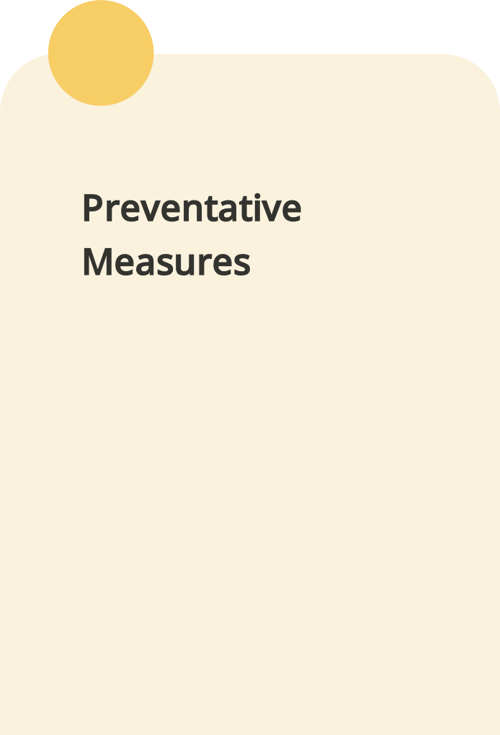
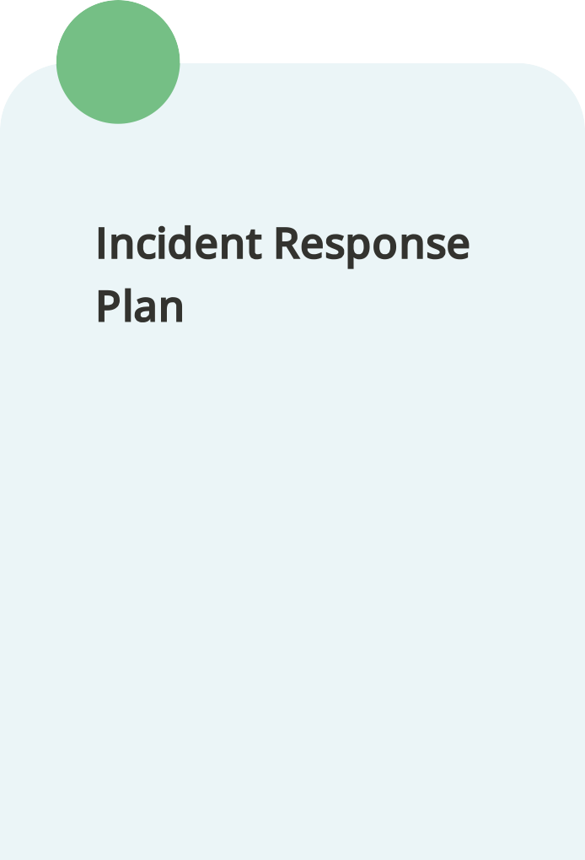
Strategies for mitigation and reporting
01
02
03
We will regularly scan company systems and clearly flag which issues are most important for us to fix first.
Everyone should keep software updated, use strong passwords, and follow company security guidelines to reduce risks.
If you notice something unusual, report it right away so our team can respond quickly and keep business running smoothly.

